Slide 1
Classical Encryption
Techniques

Slide 2
Classical encryption techniques
As opposed to modern cryptography
Goals:
  to introduce basic concepts & terminology of encryption
  to prepare us for studying modern cryptography

Slide 3
Basic terminology
Plaintext: original message to be encrypted
Ciphertext: the encrypted message
Enciphering or encryption: the process of converting plaintext into ciphertext
Encryption algorithm: performs encryption
  Two inputs: a plaintext and a secret key

Slide 4
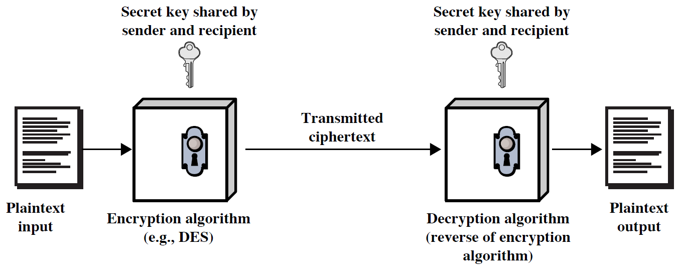
Symmetric Cipher Model

Slide 5
Deciphering or decryption: recovering plaintext from ciphertext
Decryption algorithm: performs decryption
  Two inputs: ciphertext and secret key
Secret key: same key used for encryption and decryption
  Also referred to as a symmetric key

Slide 6
Cipher or cryptographic system : a scheme for encryption and decryption
Cryptography: science of studying ciphers
Cryptanalysis: science of studying attacks against cryptographic systems
Cryptology: cryptography + cryptanalysis

Slide 7
Ciphers
Symmetric cipher: same key used for encryption and decryption
  Block cipher: encrypts a block of plaintext at a time (typically 64 or 128 bits)
  Stream cipher: encrypts data one bit or one byte at a time
Asymmetric cipher: different keys used for encryption and decryption

Slide 8
Symmetric Encryption
or conventional / secret-key / single-key
sender and recipient share a common key
all classical encryption algorithms are symmetric
The only type of ciphers prior to the invention of asymmetric-key ciphers in 1970’s
by far most widely used

Slide 9
Symmetric Encryption
Mathematically:
  Y = E_{K}(X) or Y = E(K, X)
  X = D_{K}(Y) or X = D(K, Y)
X = plaintext
Y = ciphertext
K = secret key
E = encryption algorithm
D = decryption algorithm
Both E and D are known to public

Slide 10
Cryptanalysis
Objective: to recover the plaintext of a ciphertext or, more typically, to recover the secret key.
Kerkhoff’s principle: the adversary knows all details about a cryptosystem except the secret key.
Two general approaches:
  brute-force attack
  non-brute-force attack (cryptanalytic attack)

Slide 11
Brute-Force Attack
Try every key to decipher the ciphertext.
On average, need to try half of all possible keys
Time needed proportional to size of key space
Key Size (bits) | Number of Alternative Keys | Time required at 1 decryption/µs | Time required at 10⁶ decryptions/µs
32 | 2³² = 4.3 × 10⁹ | 2³¹ µs = 35.8 minutes | 2.15 milliseconds
56 | 2⁵⁶ = 7.2 × 10¹⁶ | 2⁵⁵ µs = 1142 years | 10.01 hours
128 | 2¹²⁸ = 3.4 × 10³⁸ | 2¹²⁷ µs = 5.4 × 10²⁴ years | 5.4 × 10¹⁸ years
168 | 2¹⁶⁸ = 3.7 × 10⁵⁰ | 2¹⁶⁷ µs = 5.9 × 10³⁶ years | 5.9 × 10³⁰ years
26 characters (permutation) | 26! = 4 × 10²⁶ | 2 × 10²⁶ µs = 6.4 × 10¹² years | 6.4 × 10⁶ years

Slide 12
Cryptanalytic Attacks
May be classified by how much information needed by the attacker:
  Ciphertext-only attack
  Known-plaintext attack
  Chosen-plaintext attack
  Chosen-ciphertext attack

Slide 13
Ciphertext-only attack
Given: a ciphertext c
Q: what is the plaintext m?
An encryption scheme is completely insecure if it cannot resist ciphertext-only attacks.

Slide 14
Known-plaintext attack
Given: (m₁,c₁), (m₂,c₂), …, (m_{k},c_{k}) and a new ciphertext c.
Q: what is the plaintext of c?
Q: what is the secret key in use?

Slide 15
Chosen-plaintext attack
Given: (m₁,c₁), (m₂,c₂), …, (m_{k},c_{k}), where m₁, m₂, …, m_{k} are chosen by the adversary; and a new ciphertext c.
Q: what is the plaintext of c, or what is the secret key?

Slide 16
Example: chosen-plaintext attack
In 1942, US Navy cryptanalysts discovered that Japan was planning an attack on “AF”.
They believed that “AF” means Midway island.
Pentagon didn’t think so.
US forces in Midway sent a plain message that their freshwater supplies were low.
Shortly, US intercepted a Japanese ciphertext saying that “AF” was low on water.
This proved that “AF” is Midway.

Slide 17
Chosen-ciphertext attack
Given: (m₁,c₁), (m₂,c₂), …, (m_{k},c_{k}), where c₁, c₂, …, c_{k} are chosen by the adversary; and a new ciphertext c.
Q: what is the plaintext of c, or what is the secret key?

Slide 18
Classical Ciphers
Plaintext is viewed as a sequence of elements (e.g., bits or characters)
Substitution cipher: replacing each element of the plaintext with another element.
Transposition (or permutation) cipher: rearranging the order of the elements of the plaintext.
Product cipher: using multiple stages of substitutions and transpositions

Slide 19
Caesar Cipher
Earliest known substitution cipher
Invented by Julius Caesar
Each letter is replaced by the letter three positions further down the alphabet.
  Plain: a b c d e f g h i j k l m n o p q r s t u v w x y z
  Cipher: D E F G H I J K L M N O P Q R S T U V W X Y Z A B C
Example: NUST → Q X V W

Slide 20
Caesar Cipher
Mathematically, map letters to numbers:
  a, b, c, ..., x, y, z
  0, 1, 2, ..., 23, 24, 25
Then the general Caesar cipher is:
  c = E_{K}(p) = (p + k) mod 26
  p = D_{K}(c) = (c – k) mod 26
Can be generalized with any alphabet.

Slide 21
Cryptanalysis of Caesar Cipher
Key space: {0, 1, ..., 25}
Vulnerable to brute-force attacks.
E.g., break ciphertext "UNOU YZGZK“
Need to recognize it when have the plaintext
What if the plaintext is written in some other roman language?

Slide 22
Monoalphabetic Substitution Cipher
Shuffle the letters and map each plaintext letter to a different random ciphertext letter:
  Plain letters: abcdefghijklmnopqrstuvwxyz
  Cipher letters: DKVQFIBJWPESCXHTMYAUOLRGZN
  Plaintext: ifwewishtoreplaceletters
  Ciphertext: WIRFRWAJUHYFTSDVFSFUUFYA
What does a key look like?

Slide 23
Monoalphabetic Cipher Security
Now we have a total of 26! = 4 x 10²⁶ keys.
With so many keys, it is secure against brute-force attacks.
But not secure against some cryptanalytic attacks.
Problem is language characteristics.

Slide 24
Language Statistics and Cryptanalysis
Human languages are not random.
Letters are not equally frequently used.
In English, E is by far the most common letter, followed by T, R, N, I, O, A, S.
Other letters like Z, J, K, Q, X are fairly rare.
There are tables of single, double & triple letter frequencies for various languages

Slide 25
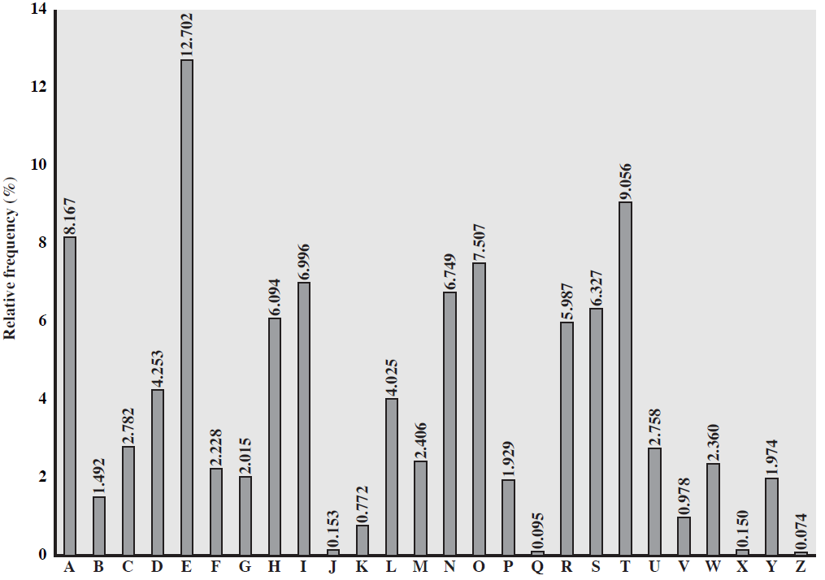
English Letter Frequencies

Slide 26
Statistics for double & triple letters
In decreasing order of frequency
Double letters:
th he an in er re es on, …
Triple letters:
the and ent ion tio for nde, …

Slide 27
Use in Cryptanalysis
Key concept: monoalphabetic substitution does not change relative letter frequencies
To attack, we
  calculate letter frequencies for ciphertext
  compare this distribution against the known one

Slide 28
Example Cryptanalysis
Given ciphertext:
  UZQSOVUOHXMOPVGPOZPEVSGZWSZOPFPESXUDBMETSXAIZ
  VUEPHZHMDZSHZOWSFPAPPDTSVPQUZWYMXUZUHSX
  EPYEPOPDZSZUFPOMBZWPFUPZHMDJUDTMOHMQ
Count relative letter frequencies (see next page)
Guess {P, Z} = {e, t}
Of double letters, ZW has highest frequency, so guess ZW = th and hence ZWP = the
Proceeding with trial and error finally get:
  it was disclosed yesterday that several informal but
  direct contacts have been made with political
  representatives of the viet cong in moscow

Slide 29
Letter frequencies in ciphertext
P 13.33 | H 5.83 | F 3.33 | B 1.67 | C 0.00
Z 11.67 | D 5.00 | W 3.33 | G 1.67 | K 0.00
S 8.33 | E 5.00 | Q 2.50 | Y 1.67 | L 0.00
U 8.33 | V 4.17 | T 2.50 | I 0.83 | N 0.00
O 7.50 | X 4.17 | A 1.67 | J 0.83 | R 0.00
M 6.67

Slide 30
Playfair Cipher
Not even the large number of keys in a monoalphabetic cipher provides security.
One approach to improving security is to encrypt multiple letters at a time.
The Playfair Cipher is the best known such cipher.
Invented by Charles Wheatstone in 1854, but named after his friend Baron Playfair.

Slide 31
Playfair Key Matrix
Use a 5 x 5 matrix.
Fill in letters of the key (w/o duplicates).
Fill the rest of matrix with other letters.
E.g., key = MONARCHY.
M | O | N | A | R
C | H | Y | B | D
E | F | G | I/J | K
L | P | Q | S | T
U | V | W | X | Z

Slide 32
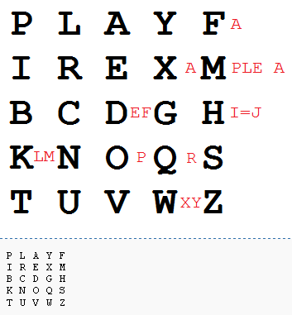
Example
http://en.wikipedia.org/wiki/Playfair_cipher
Key: playfair example

Slide 33
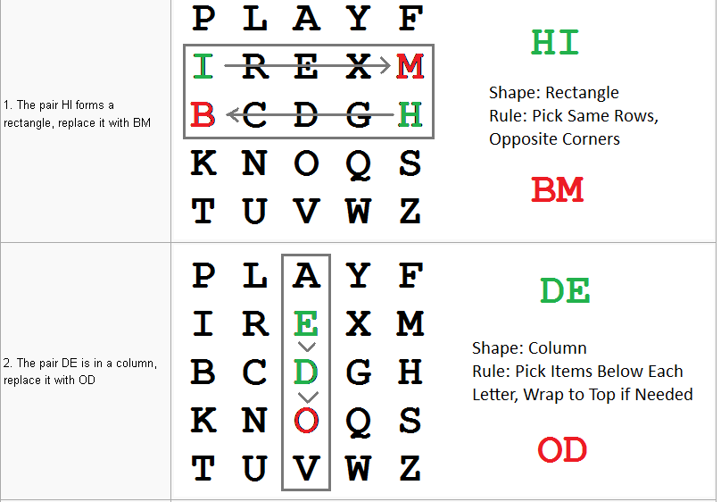
Message: Hide the gold in the tree stump
Digraph: HI DE TH EG OL DI NT HE TR EX ES TU MP

Slide 34
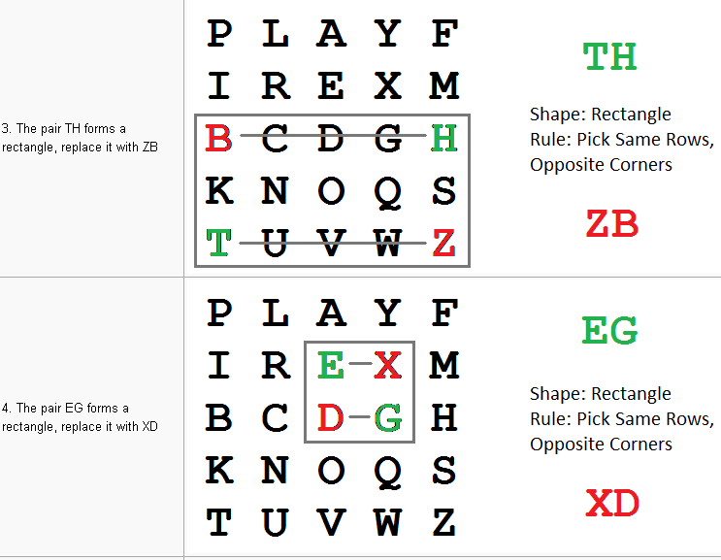

Slide 35
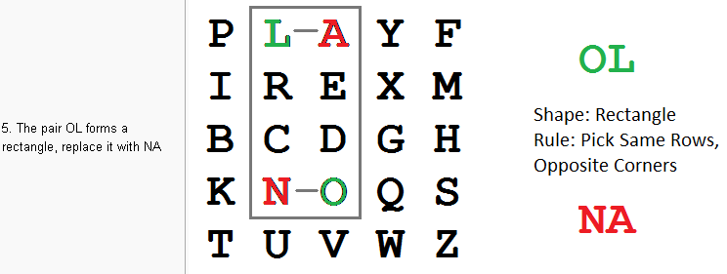
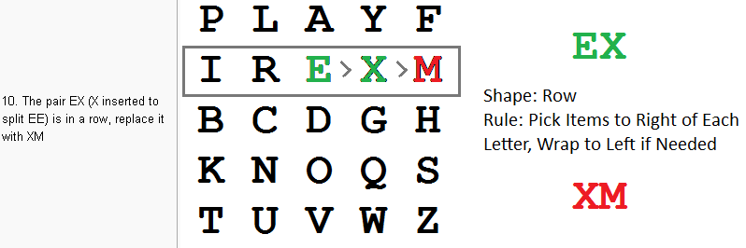
Encrypted Message: BMODZBXDNABEKUDMUIXMMOUVIF

Slide 36
Encrypting and Decrypting
Plaintext is encrypted two letters at a time.
  If a pair is a repeated letter, insert filler like 'X’.
  If both letters fall in the same row, replace each with the letter to its right (circularly).
  If both letters fall in the same column, replace each with the the letter below it (circularly).
  Otherwise, each letter is replaced by the letter in the same row but in the column of the other letter of the pair.

Slide 37
Security of Playfair Cipher
Security is much improved over the simple monoalphabetic cipher.
Was widely used for many decades
  eg. by US & British military in WW1 and early WW2
Once thought to be unbreakable.
Actually, it can be broken, because it still leaves some structure of plaintext intact.

Slide 38
Polyalphabetic Substitution Ciphers
A sequence of monoalphabetic ciphers (M₁, M₂, M₃, ..., M_{k}) is used in turn to encrypt letters.
A polyalphabetic cipher is any cipher based on substitution, using multiple substitution alphabets.
A key determines which sequence of ciphers to use.
Each plaintext letter has multiple corresponding ciphertext letters.
This makes cryptanalysis harder since the letter frequency distribution will be flatter.

Slide 39
Vigenère Cipher
Simplest polyalphabetic substitution cipher
Consider the set of all Caesar ciphers:
{ C_{a}, C_{b}, C_{c}, ..., C_{z} }
Key: e.g. security
Encrypt each letter using C_{s}, C_{e}, C_{c}, C_{u}, C_{r}, C_{i}, C_{t}, C_{y} in turn.
Repeat from start after C_{y}.
Decryption simply works in reverse.

Slide 40
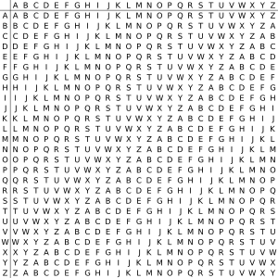

Slide 41
Example of Vigenère Cipher
Keyword: deceptive
  key: deceptivedeceptivedeceptive
  plaintext: wearediscoveredsaveyourself
  ciphertext: ZICVTWQNGRZGVTWAVZHCQYGLMGJ

Slide 42
Security of Vigenère Ciphers
There are multiple ciphertext letters corresponding to each plaintext letter.
So, letter frequencies are obscured but not totally lost.
To break Vigenere cipher:
  Try to guess the key length. How?
  If key length is N, the cipher consists of N Caesar ciphers. Plaintext letters at positions k, N+k, 2N+k, 3N+k, etc., are encoded by the same cipher.
  Attack each individual cipher as before.

Slide 43
Guessing the Key Length
Main idea: Plaintext words separated by multiples of the key length are encoded in the same way.
In our example, if plaintext = “…thexxxxxxthe…” then “the” will be encrypted to the same ciphertext words.
So look at the ciphertext for repeated patterns.
E.g. repeated “VTW” in the previous example suggests a key length of 3 or 9:
  ciphertext: ZICVTWQNGRZGVTWAVZHCQYGLMGJ
Of course, the repetition could be a random fluke.

Slide 44
Rotor Cipher Machines
Before modern ciphers, rotor machines were most common complex ciphers in use.
Widely used in WW2.
Used a series of rotating cylinders.
Implemented a polyalphabetic substitution cipher of period K.
With 3 cylinders, K = 26³ =17,576.
With 5 cylinders, K = 26⁵ =12 x 10⁶.
What is a key?
  If the adversary has a machine
  If the adversary doesn’t have a machine

Slide 45
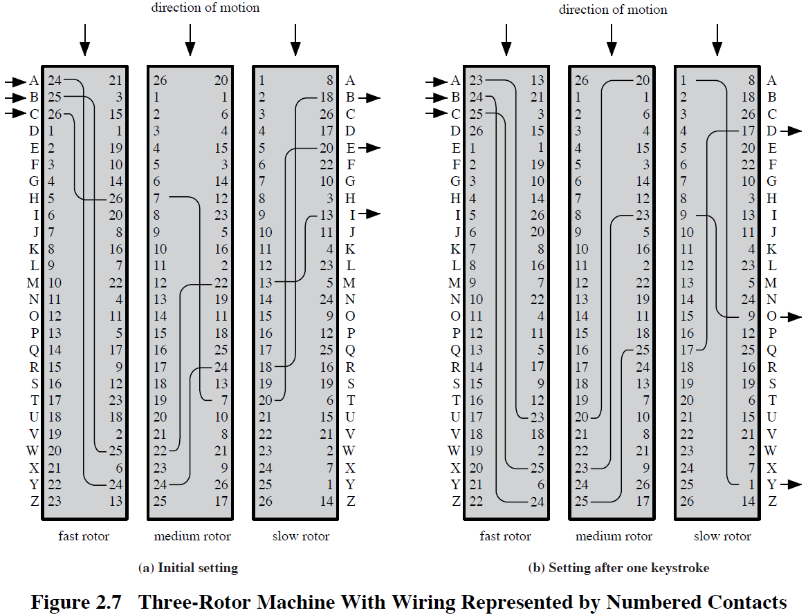

Slide 46
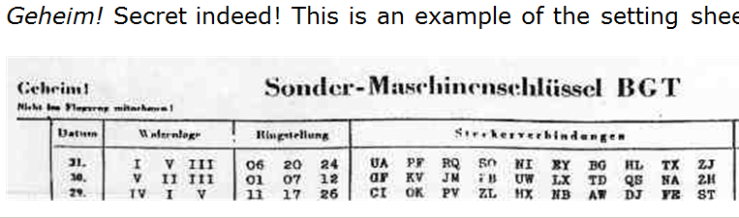
German secret setting sheets
Date
Which rotors to use (there were 10 rotors)
Ring setting
Plugboard setting

Slide 47
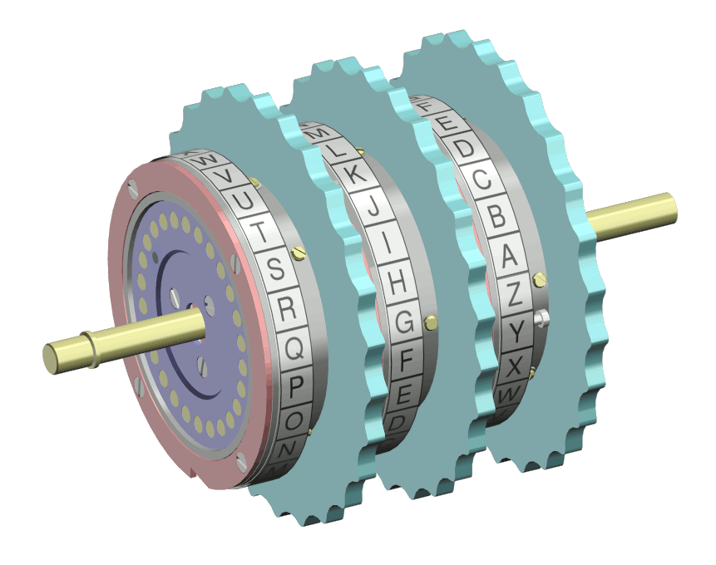
The Rotors

Slide 48
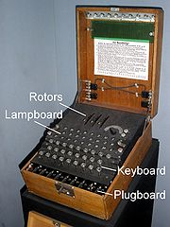
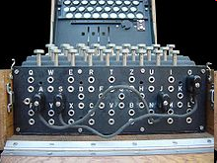
Enigma Rotor Machine

Slide 49
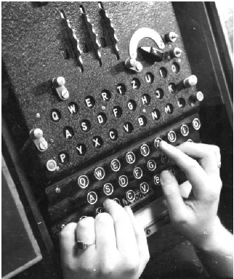
Enigma Rotor Machine

Slide 50
Transposition Ciphers
Also called permutation ciphers.
Shuffle the plaintext, without altering the actual letters used.
Example: Row Transposition Ciphers

Slide 51
Row Transposition Ciphers
Plaintext is written row by row in a rectangle.
Ciphertext: write out the columns in an order specified by a key.
  Key: 3 4 2 1 5 6 7
  Plaintext:
  Ciphertext: TTNAAPTMTSUOAODWCOIXKNLYPETZ
a | t | t | a | c | k | p
o | s | t | p | o | n | e
d | u | n | t | i | l | t
w | o | a | m | x | y | z

Slide 52
Product Ciphers
Uses a sequence of substitutions and transpositions
  Harder to break than just substitutions or transpositions
This is a bridge from classical to modern ciphers.

Slide 53
Unconditional & Computational Security
A cipher is unconditionally secure if it is secure no matter how much resources (time, space) the attacker has.
A cipher is computationally secure if the best algorithm for breaking it will require so much resources (e.g., 1000 years) that practically the cryptosystem is secure.
All the ciphers we have examined are not unconditionally secure.

Slide 54
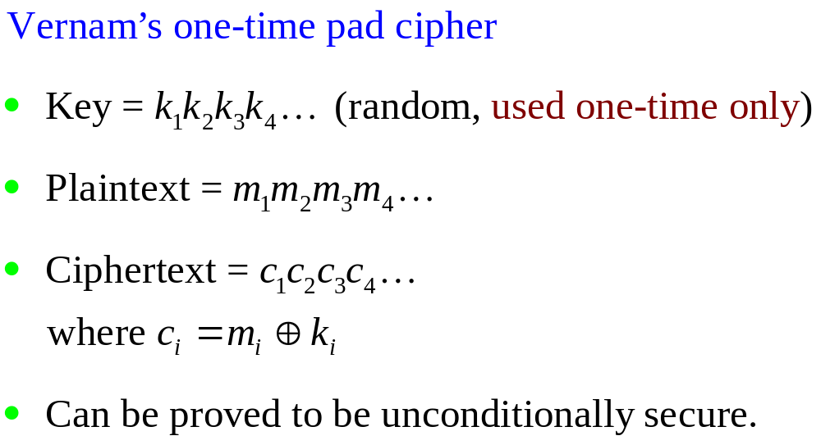
An unconditionally Secure Cipher

Slide 55
One-Time Pad
if a truly random key as long as the message is used, the cipher will be secure
called a One-Time pad
is unbreakable since ciphertext bears no statistical relationship to the plaintext
since for any plaintext & any ciphertext there exists a key mapping one to other
can only use the key once though
problems in generation & safe distribution of key
Notes:
The One-Time Pad is an evolution of the Vernham cipher, which was invented by Gilbert Vernham in 1918, and used a long tape of random letters to encrypt the message. An Army Signal Corp officer, Joseph Mauborgne, proposed an improvement using a random key that was truly as long as the message, with no repetitions, which thus totally obscures the original message. It produces random output that bears no statistical relationship to the plaintext. Because the ciphertext contains no information whatsoever about the plaintext, there is simply no way to break the code, since any plaintext can be mapped to any ciphertext given some key.
The one-time pad offers complete security but, in practice, has two fundamental difficulties:
There is the practical problem of making large quantities of random keys.
2. And the problem of key distribution and protection, where for every message to be sent, a key of equal length is needed by both sender and receiver.
Because of these difficulties, the one-time pad is of limited utility, and is useful primarily for low-bandwidth channels requiring very high security.

Slide 56
Steganography
Hide a message in another message.
E.g., hide your plaintext in a graphic image
  Each pixel has 3 bytes specifying the RGB color
  The least significant bits of pixels can be changed w/o greatly affecting the image quality
  So can hide messages in these LSBs
Advantage: hiding existence of messages
Drawback: high overhead

Slide 57
Slides are taken from Chapter 2 of Cryptography and Network William Stallings

